Slide 1

Solar Panel Damage Detection
Solar panels are a critical component in the generation of renewable energy, converting sunlight into electricity. However, like any infrastructure, they are susceptible to various types of damage that can significantly affect their efficiency and lifespan. Effective detection and timely repair of these damages are essential to maintaining optimal performance and ensuring the longevity of solar panels.

Slide 2

Project Leadership
Sharat Manikonda
Director at Innodatatics and Sponsor
linkedin.com/in/sharat-chandra

Slide 3
Members
Name: Uzman Ansari
www.linkedin.com/in/uzman-ansari-411820224

Slide 4

Contents
Business objective
Business Constraints
Project Architecture
Data collection and details
Exploratory Data Analysis
Visualization
Modeling
Evaluation
Deployment
Notes:
Change

Slide 5
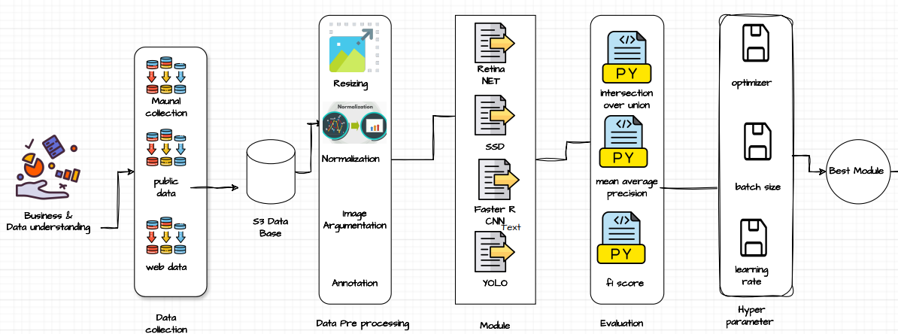
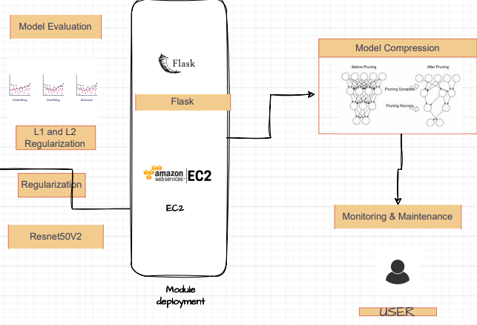
Project Overview and Scope

Slide 6
Business Problem
Economic Impact:
Increased operational costs due to frequent manual inspections and reactive maintenance.
Loss of revenue from decreased energy production when damaged panels are not promptly detected and repaired.
Operational Impact:
Downtime of solar panels affects the overall energy output and reliability of the solar power system.
Inefficiency in resource allocation leads to increased labor and material costs.
Environmental Impact:
Reduced efficiency of solar panels can lead to higher dependency on non-renewable energy sources to meet energy demands.
Cost Savings:
Significant reduction in maintenance costs by minimizing manual inspections and enabling timely repairs.
Lower operational costs due to improved efficiency and reduced downtime of solar panels.
Increased Energy Production:
Maximized energy output by ensuring that solar panels are always operating at optimal efficiency.
Increased revenue from the consistent performance of solar power systems.
Enhanced Reliability:
Improved reliability and lifespan of solar panel installations through regular and predictive maintenance.

Slide 7
Business Objective
Constraints
Minimize maintenance costs
Automated Monitoring:
Predictive Maintenance
Efficient Resource Allocation:
Remote Diagnostics
Ensure High Detection Accuracy
High-Resolution Imaging:
Advanced Algorithms:
Regular Calibration:
Objective
Maximize solar PV system uptime

Slide 8
CRISP-ML(Q) Methodology
There are six stages of CRISP-ML(Q) Methodology
1.Business and data understanding
2.Data preparation
3.model building
4.Model evaluation
5.Model deployment
6.Monitoring and maintenance

Slide 9


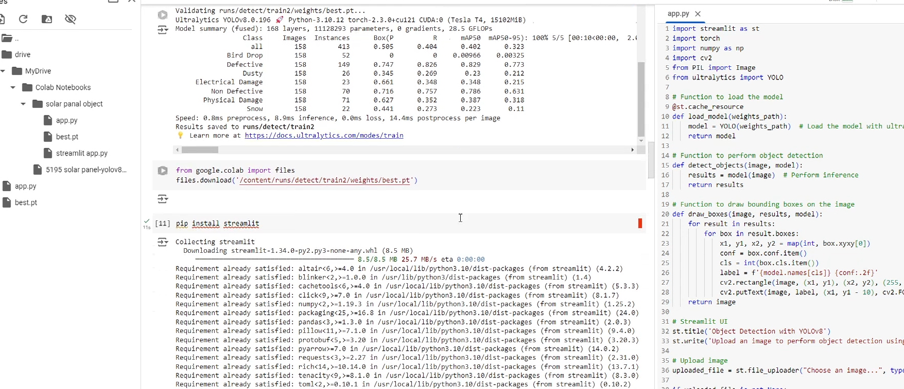
Technical Stacks
Data Collection
Data Storage and Management
Data Processing and Analysis
Model Training and Deployment
Training Environment:
Machine Learning and Deep Learning:
TensorFlow
Machine Learning and Deep Learning:
Scikit-learn
Machine Learning and Deep Learning:
PyTorch
Keras
Google Colab
Training Model Using YOLOv8 Epochs 50
Data Annotation:
Robo flow offers robust annotation tools that make it easy to label images for various tasks like object detection
Data Augmentation
Built-In Augmentation Techniques: Roboflow provides a range of data augmentation options (e.g., rotation, flipping, scaling, noise addition)

Slide 10
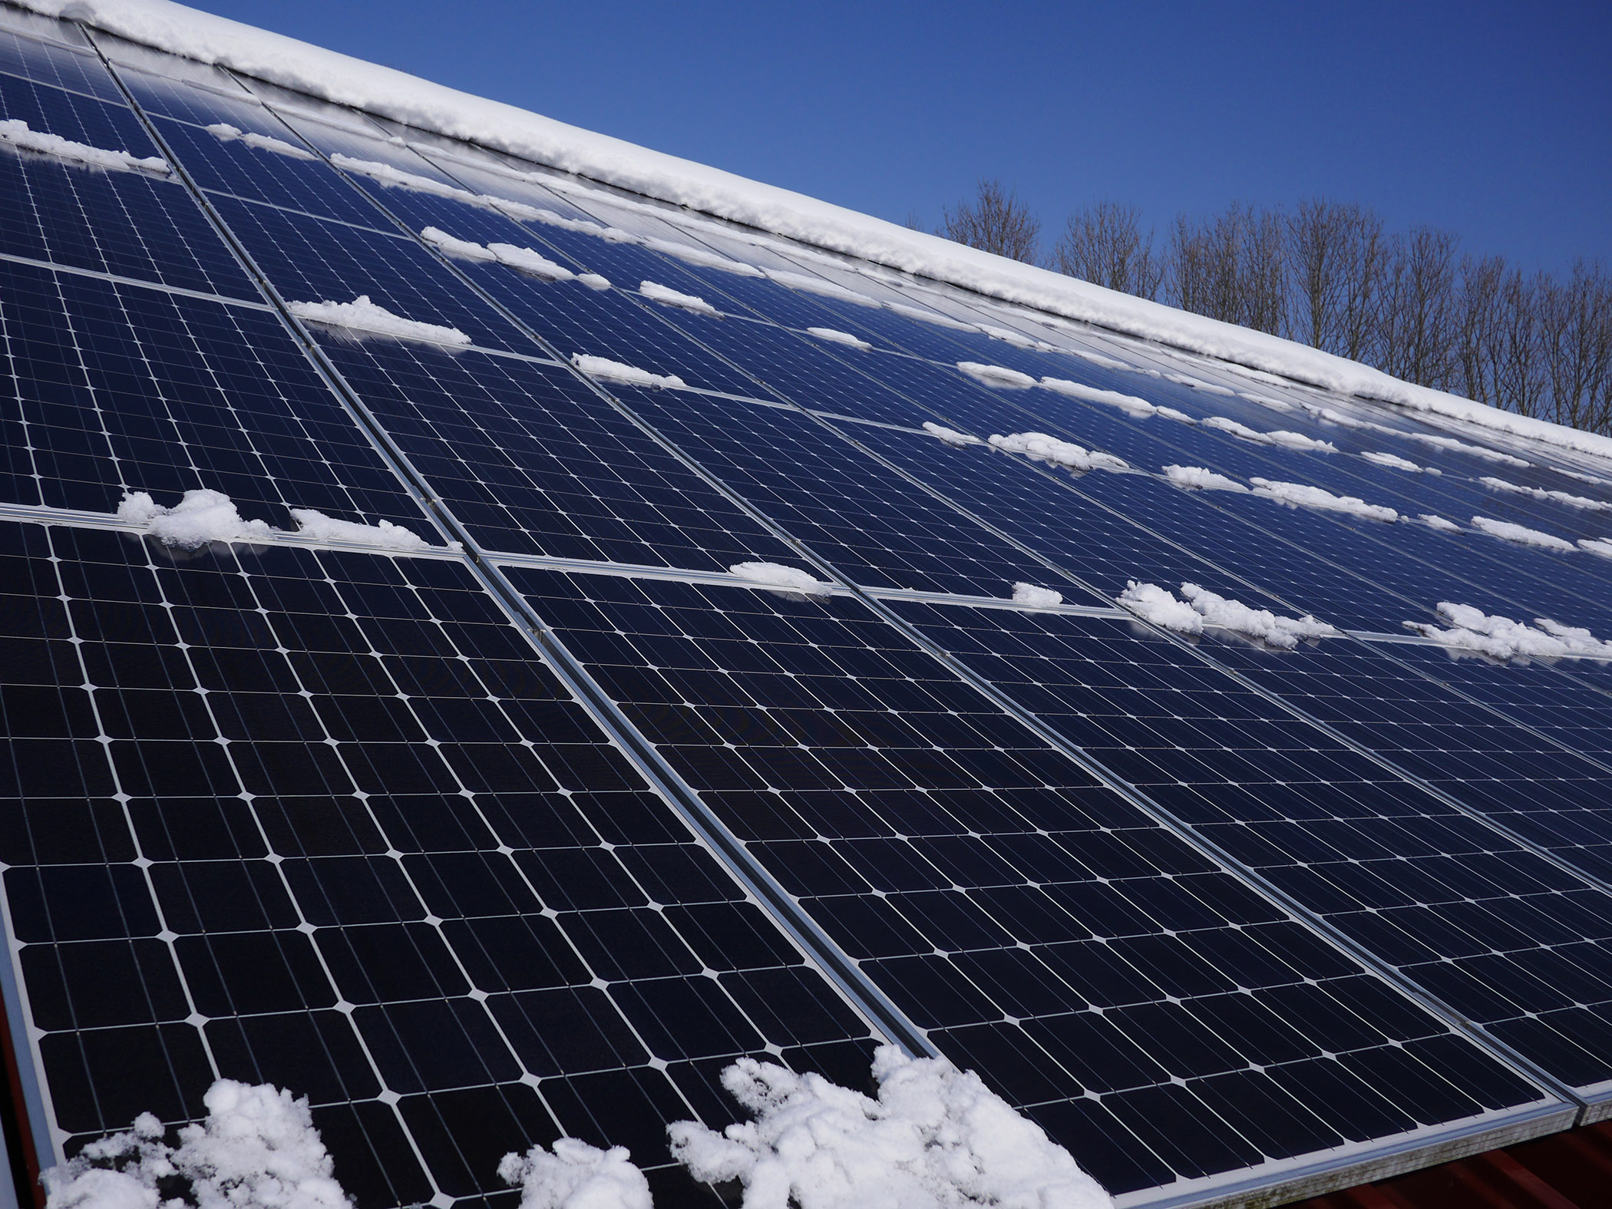
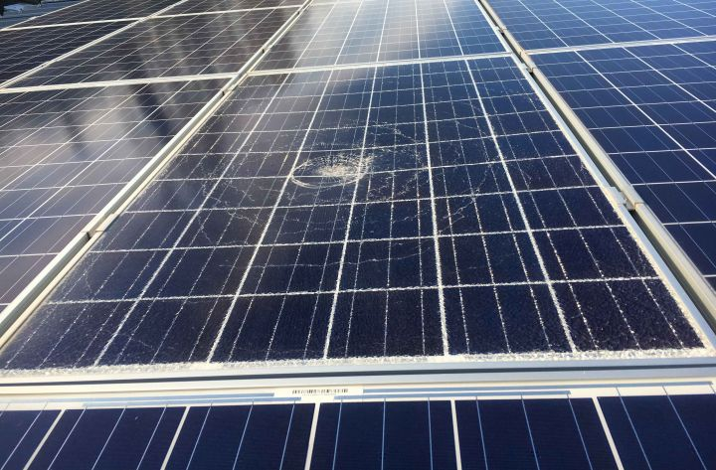
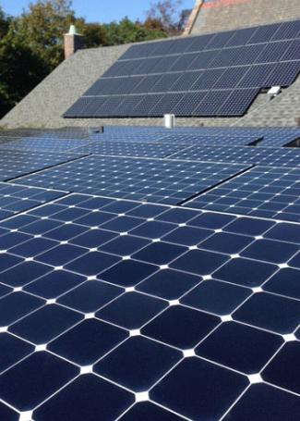
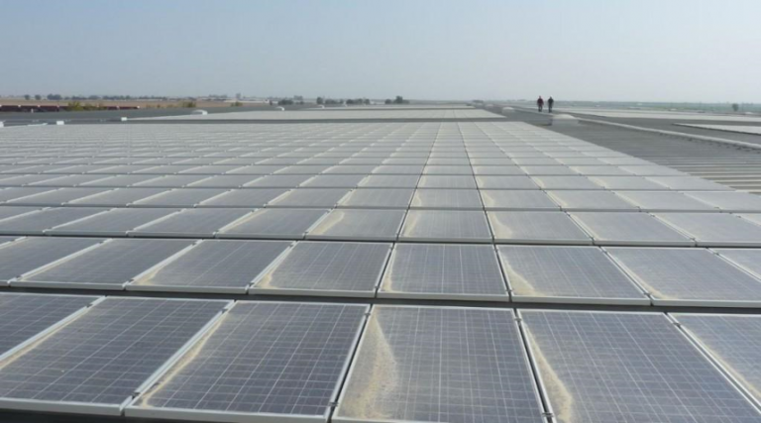
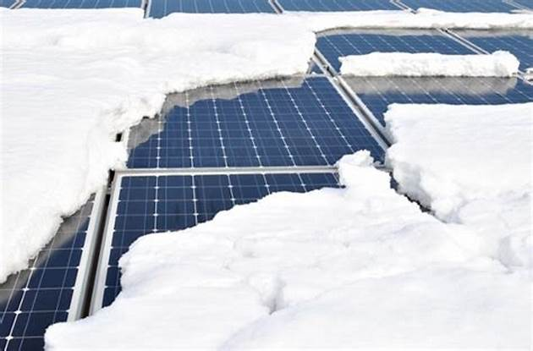
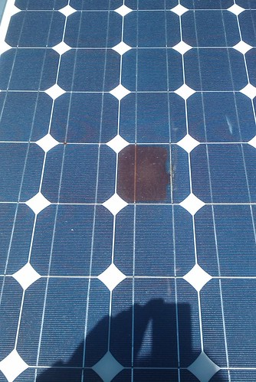
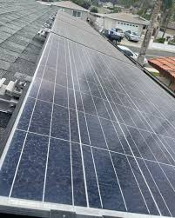
Data Collection and Understanding
Classes For Annotation we used
Defective
Bird drop
Dusty
Electrical Damage
Physical Damage
Snow
Non Defective
First we identify which type of Classes for Annotation we used:

Slide 11
Data Information
Resolution Format
Bounding Boxes
Labels
Annotation Format
Number of Images
Normalization
Instances per Class
Resizing
Field Surveys
Satellite Imagery
Training Set
Validation Set
Test Set
Data Cleaning
Removing Duplicates
Removing Duplicates
Quality Check

Slide 12
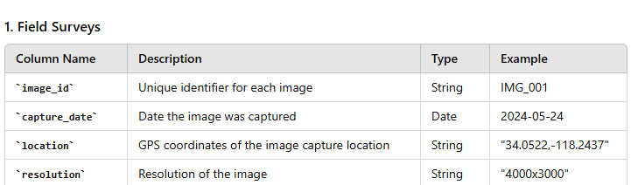
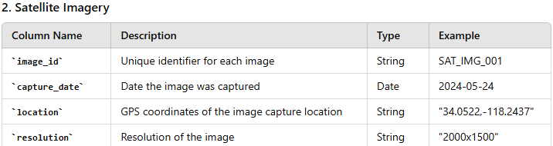
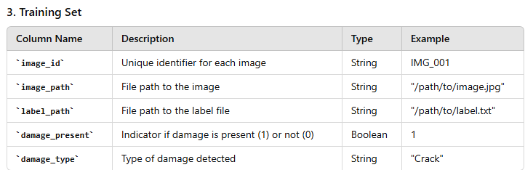
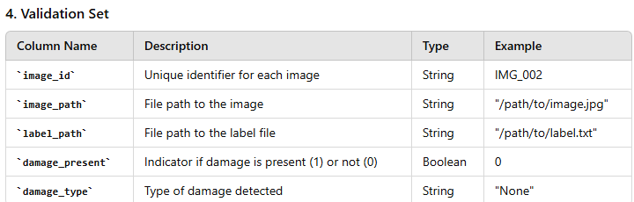
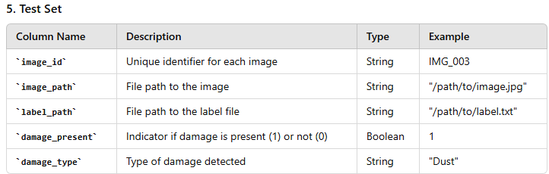
Data Dictionary

Slide 13
System Requirements
Hardware Requirements
Software Requirements:
Operating System
Windows 10 or later
macOS 10.15 (Catalina) or later
Linux (Ubuntu 18.04 or later)
Programming Languages
Python 3.7 or later
Development Environment
Jupyter Notebook
Google Colab (for cloud-based development)
Integrated Development Environment (IDE) like VS Code or PyCharm
Dependencies and Libraries
PyTorch: For model development and training
OpenCV For image processing
NumPy: For numerical operations
PIL (Pillow) For image manipulation
Streamlit: For creating the web application interface
Matplotlib/Seaborn: For data visualization
Scikit-learn: For additional machine learning tools
Roboflow: For data augmentation and management
TensorFlow (optional): For additional machine learning capabilities
Processor (CPU)
Minimum: Intel Core i5 or equivalent
Recommended: Intel Core i7 or AMD Ryzen 7 or higher
Memory (RAM)
Minimum: 8 GB
Recommended: 16 GB or higher
Graphics Card (GPU)
Minimum: NVIDIA GTX 1050
Recommended: NVIDIA RTX 2060 or higher
Storage
Minimum: 100 GB of free disk space
Recommended: SSD with 500 GB or more for faster data access and model training
Display
Minimum: 1080p resolution
Recommended: 4K resolution for better visualization of images and results
Roboflow
Used for data annotation, augmentation, and management. Ensure you have an account and necessary access.
Cloud Services like
Google Cloud Platform (GCP), AWS, or Azure for scalable computing resources

Slide 14
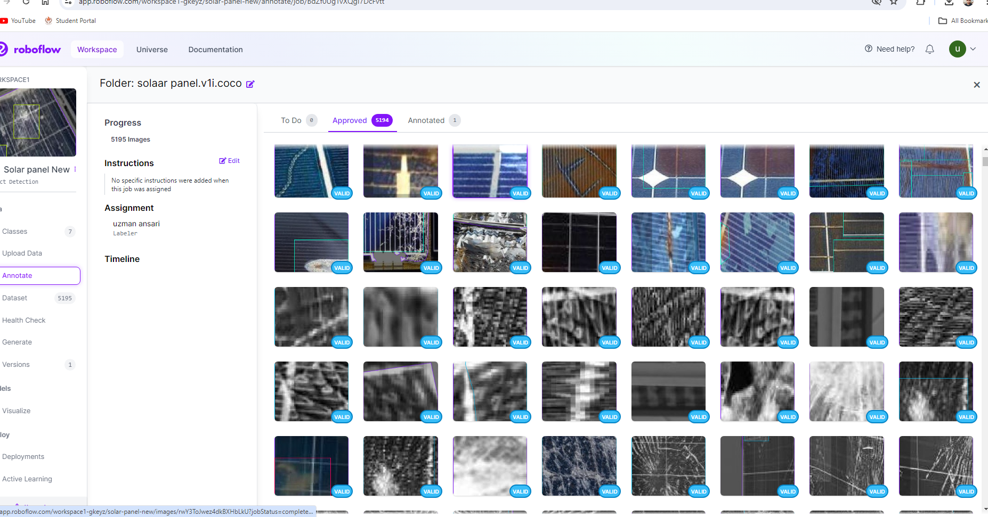
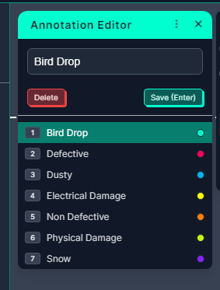
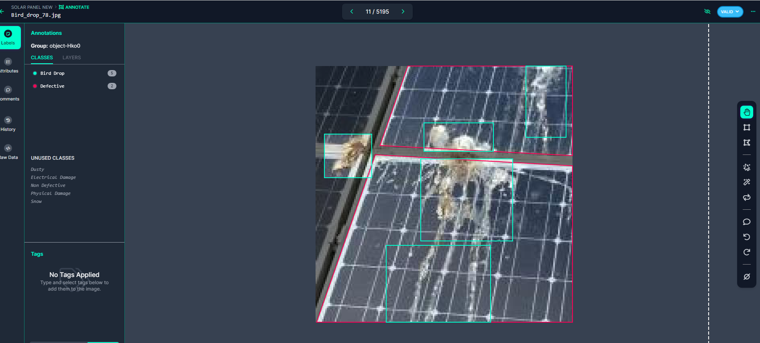
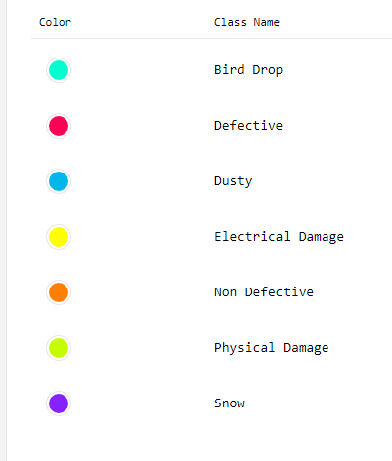
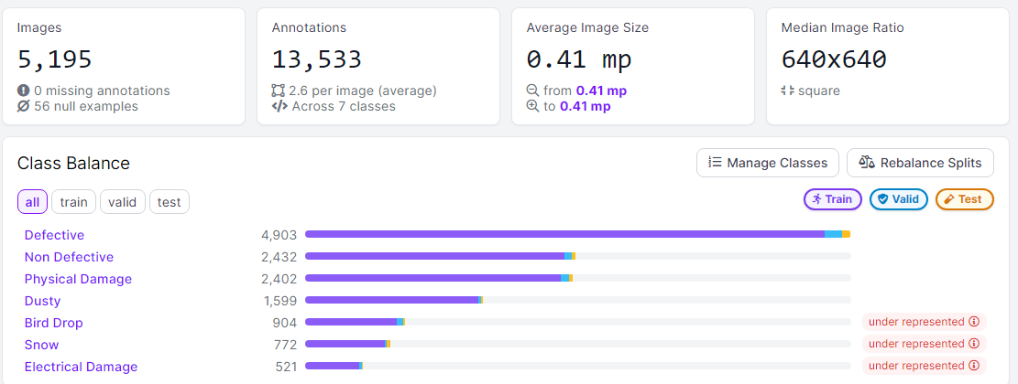
Annotation
Annotation using Roboflow
Class Name
Notes:
EDA is used for seeing what the data can tell us before the modeling task.
Change

Slide 15
Missing Values Observation
Data Augmentation
Rotation
Scaling
Flipping (horizontal or vertical)
Adding noise
Adjusting brightness or contrast
For underrepresented class, artificially increase their number by applying various transformations to existing images
Overrepresented or underrepresented
Oversampling
Random Oversampling: Duplicate samples from the minority class.
The issue of overrepresented or underrepresented classes in your dataset, I can apply several strategies to balance the class distribution
Undersampling
Random Undersampling: Randomly remove samples from the majority class.

Slide 16
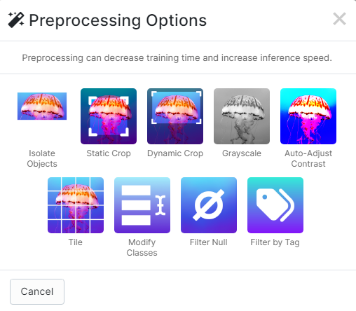
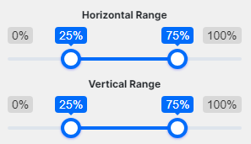
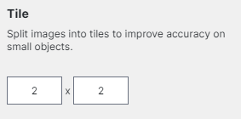
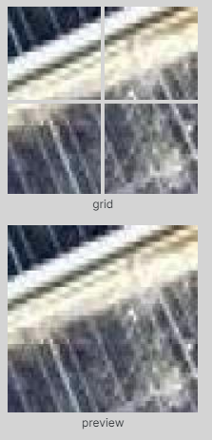
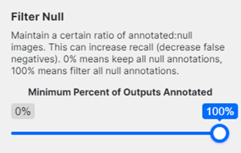
Data Preprocessing
Isolate Objects
Crop and extract bounding boxes into individual images. (Converts an object detection dataset into a classification dataset.)
Static Crop
Crop each image to the specified section, such as the bottom third.
Notes:
Keep observations

Slide 17
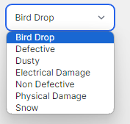
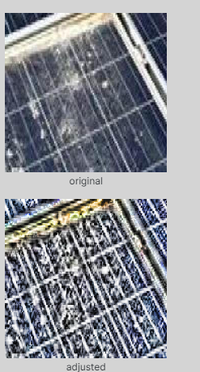
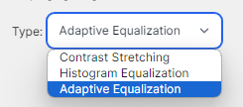
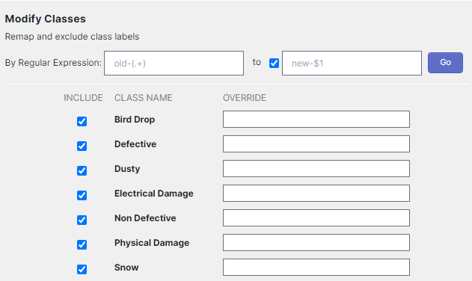
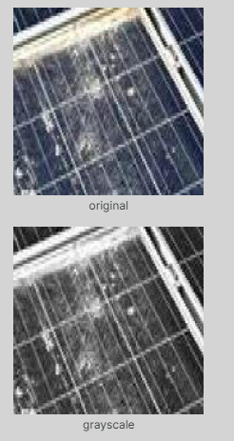
Data Preprocessing
Dynamic Crop
Crop each image to an annotated region of interest. Each image must have exactly one bounding box of the selected class (or it will not be included in the generated version)
Auto-Adjust Contrast
Boosts contrast based on the image's histogram to improve normalization and line detection in varying lighting conditions.
Choose which class you want to apply
Grayscale
Merge color channels to make your model faster and insensitive to subject color

Slide 18
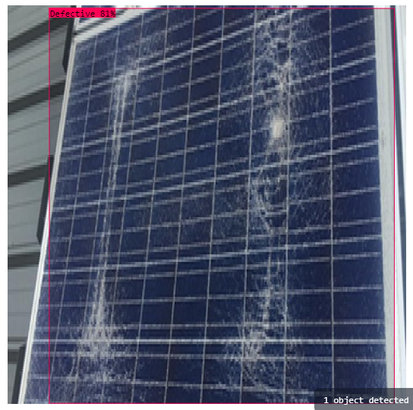
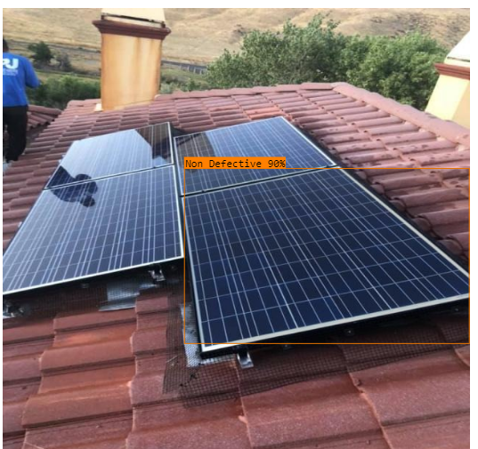
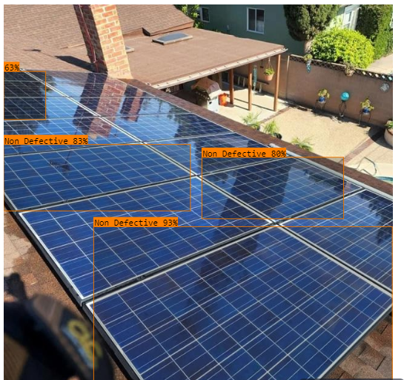
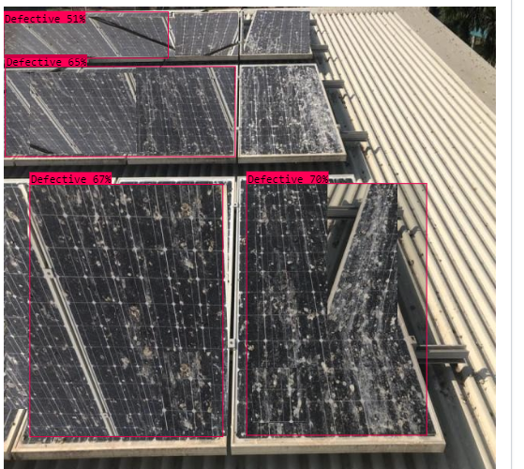
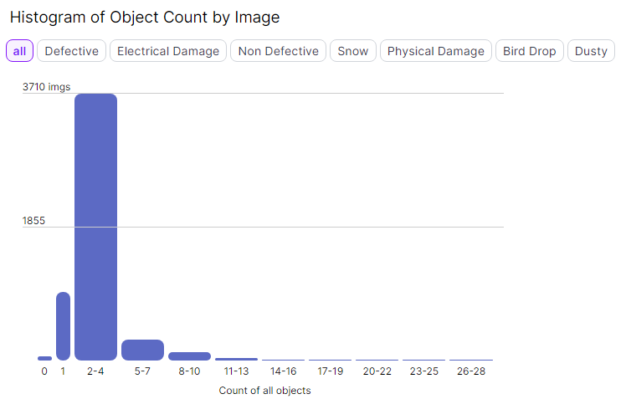
Data Visualization
Notes:
Add graphical

Slide 19
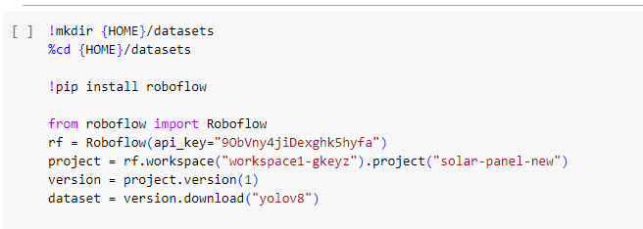
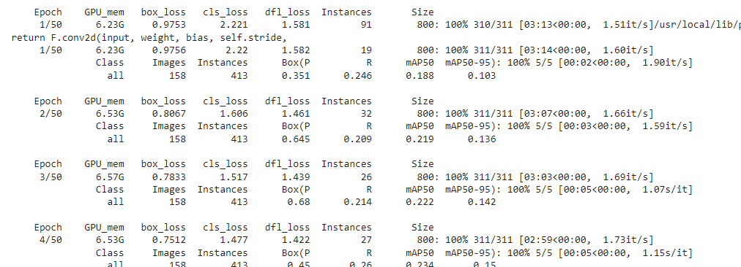
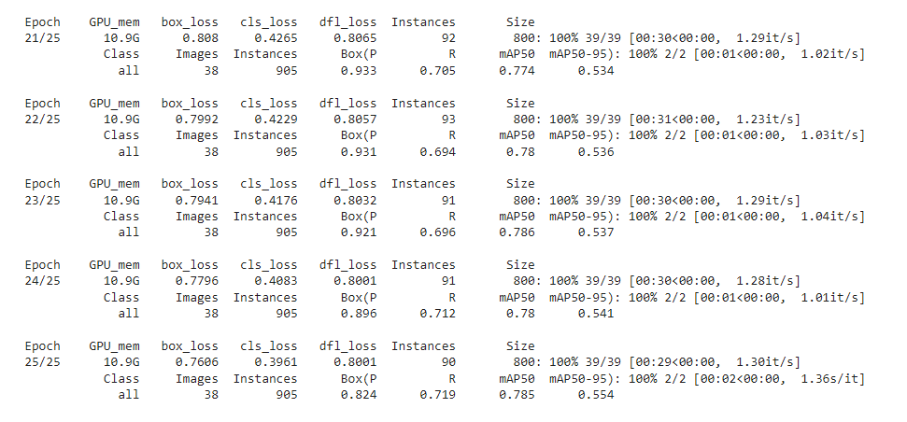
Model Building
Model yolov8 epochs 50
Model summary (fused): 168 layers, 11128293 parameters, 0 gradients, 28.5 GFLOPs
Class Images Instances Box(P R mAP50 mAP50-95):
100% 5/5 [00:10<00:00, 2.09s/it]
all 158 413 0.505 0.404 0.402 0.323
Bird Drop 158 52 0 0 0.00966 0.00325
Defective 158 149 0.747 0.826 0.829 0.773
Dusty 158 26 0.345 0.269 0.23 0.212
Electrical Damage 158 23 0.661 0.348 0.348 0.215
Non Defective 158 70 0.716 0.757 0.786 0.631
Physical Damage 158 71 0.627 0.352 0.387 0.318
Snow 158 22 0.441 0.273 0.223 0.11
Notes:
classification is the task of predicting a discrete class label. Regression is the task of predicting a continuous quantity.
What is classification techniques in machine learning?
The Classification algorithm is a Supervised Learning technique that is used to identify the category of new observations on the basis of training data. In Classification, a program learns from the given dataset or observations and then classifies new observation into several classes or groups.
What is regression techniques in machine learning?
Regression is a technique for investigating the relationship between independent variables or features and a dependent variable or outcome. It's used as a method for predictive modeling in machine learning, in which an algorithm is used to predict continuous outcomes.

Slide 20
Model Accuracy Comparison
YOLOv8 epoch 35
Model summary (fused): 168 layers, 11128293 parameters, 0 gradients, 28.5 GFLOPs
Class Images Instances Box(P R mAP50 mAP50-95):
100% 6/6 [00:12<00:00, 2.05s/it]
all 174 1283 0.295 0.286 0.202 0.136
Bird Drop 174 234 0.259 0.244 0.15 0.0576
Defective 174 219 0.343 0.616 0.452 0.343
Dusty 174 158 0.203 0.323 0.126 0.0839
Electrical Damage 174 48 0.315 0.125 0.113 0.0647
Non Defective 174 296 0.431 0.486 0.36 0.257
Physical Damage 174 178 0.42 0.157 0.171 0.122
Snow 174 150 0.0963 0.0533 0.0444 0.023
Speed: 0.8ms preprocess, 9.0ms inference, 0.0ms loss, 12.1ms postprocess per image
Yolov8 25 epochs
Model summary (fused): 168 layers, 11128293 parameters, 0 gradients, 28.5 GFLOPs
Class Images Instances Box(P R mAP50 mAP50-95):
100% 6/6 [00:14<00:00, 2.38s/it]
all 174 1283 0.325 0.269 0.209 0.139
Bird Drop 174 234 0.23 0.265 0.15 0.0552
Defective 174 219 0.438 0.584 0.397 0.308
Dusty 174 158 0.238 0.154 0.157 0.108
Electrical Damage 174 48 0.272 0.125 0.106 0.0541
Non Defective 174 296 0.363 0.564 0.443 0.312
Physical Damage 174 178 0.578 0.152 0.177 0.115
Snow 174 150 0.152 0.04 0.0346 0.0172
Speed: 1.0ms preprocess, 8.2ms inference, 0.0ms loss, 11.5ms postprocess per image
Model yolov8 epochs 50
Model summary (fused): 168 layers, 11128293 parameters, 0 gradients, 28.5 GFLOPs
Class Images Instances Box(P R mAP50 mAP50-95):
100% 5/5 [00:10<00:00, 2.09s/it]
all 158 413 0.505 0.404 0.402 0.323
Bird Drop 158 52 0 0 0.00966 0.00325
Defective 158 149 0.747 0.826 0.829 0.773
Dusty 158 26 0.345 0.269 0.23 0.212
Electrical Damage 158 23 0.661 0.348 0.348 0.215
Non Defective 158 70 0.716 0.757 0.786 0.631
Physical Damage 158 71 0.627 0.352 0.387 0.318
Snow 158 22 0.441 0.273 0.223 0.11
YOLOv8 epoch30
Model summary (fused): 168 layers, 11128293 parameters, 0 gradients, 28.5 GFLOPs
Class Images Instances Box(P R mAP50 mAP50-95):
100% 6/6 [00:12<00:00, 2.12s/it]
all 174 1283 0.298 0.292 0.203 0.137
Bird Drop 174 234 0.246 0.205 0.14 0.0553
Defective 174 219 0.419 0.594 0.379 0.295
Dusty 174 158 0.245 0.342 0.169 0.106
Electrical Damage 174 48 0.163 0.125 0.126 0.0872
Non Defective 174 296 0.417 0.493 0.369 0.266
Physical Damage 174 178 0.49 0.191 0.195 0.124
Snow 174 150 0.107 0.0933 0.0424 0.0225

Slide 21
Best Model –
Model yolov8 epochs 50
Model summary (fused): 168 layers, 11128293 parameters, 0 gradients, 28.5 GFLOPs
Class Images Instances Box(P R mAP50 mAP50-95):
100% 5/5 [00:10<00:00, 2.09s/it]
all 158 413 0.505 0.404 0.402 0.323
Bird Drop 158 52 0 0 0.00966 0.00325
Defective 158 149 0.747 0.826 0.829 0.773
Dusty 158 26 0.345 0.269 0.23 0.212
Electrical Damage 158 23 0.661 0.348 0.348 0.215
Non Defective 158 70 0.716 0.757 0.786 0.631
Physical Damage 158 71 0.627 0.352 0.387 0.318
Snow 158 22 0.441 0.273 0.223 0.11
mAP50
mAP50-95
0.402
0.323
40.2%
32.3%
best.pt
Notes:
Why Random Forest Regression is good?
A Random Forest Regression model is powerful and accurate. It usually performs great on many problems, including features with non-linear relationships
How is XGBoost different from random forest?
One of the most important differences between XG Boost and Random forest is that the XGBoost always gives more importance to functional space when reducing the cost of a model while Random Forest tries to give more preferences to hyperparameters to optimize the model..
n_estimators — the number of decision trees you will be running in the model

Slide 22
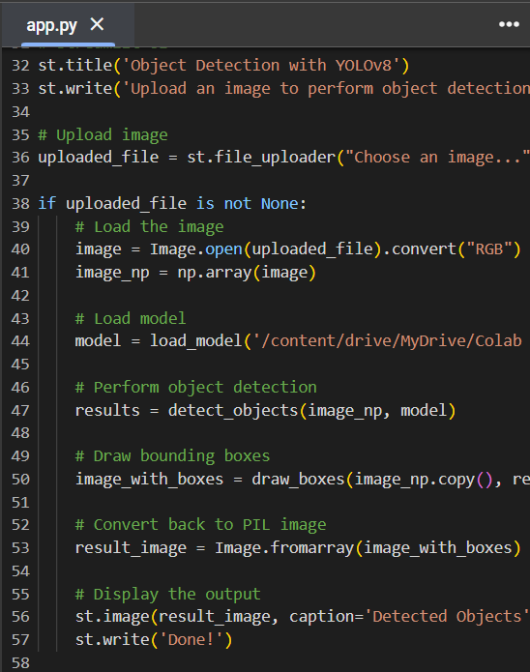
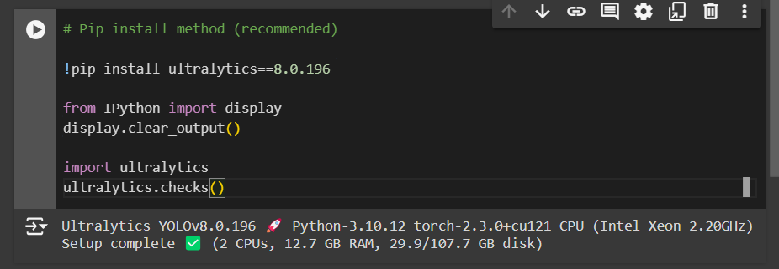
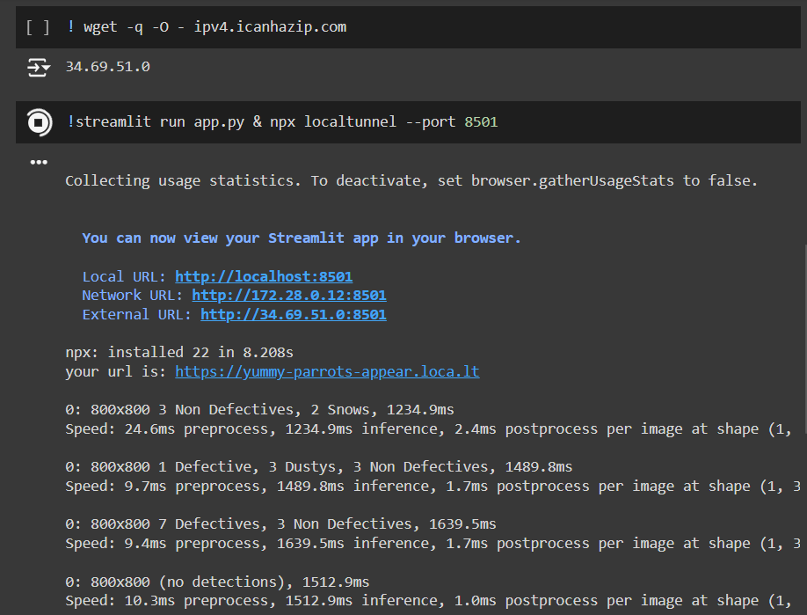
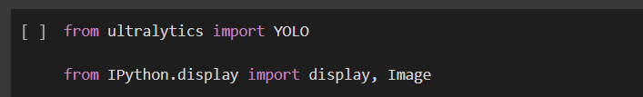
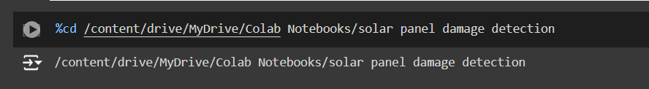
Model Deployment - Strategy
Step 1
Step 5
Step 2
Step 3
best.pt
App.py
Upload in Google drive
Mount G Drive in Colab
Important Libraries
!pip install streamlit
!pip install ultralytics
!pip install pillow
!pip install opencv-python-headless
!pip install torch torchvision
!pip install opencv-python-headless
! wget -q -O - ipv4.icanhazip.com
! streamlit run app.py & npx localtunnel --port 8501
Step 4
Change Directory

Slide 23
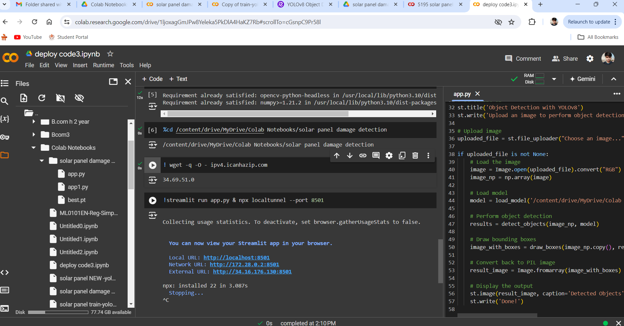
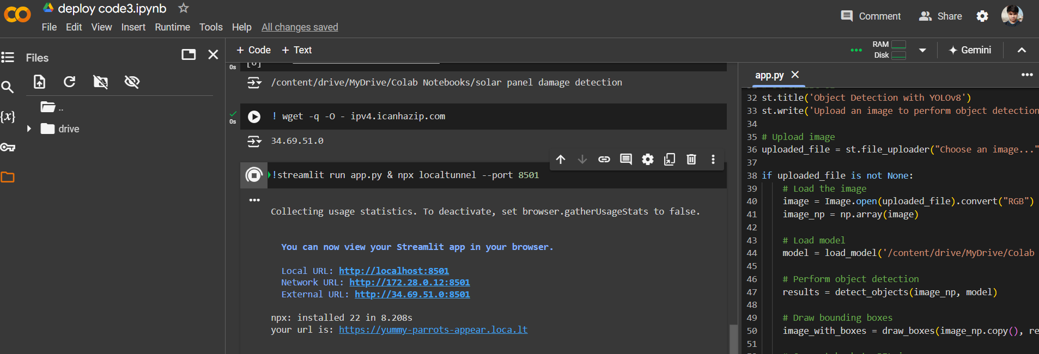
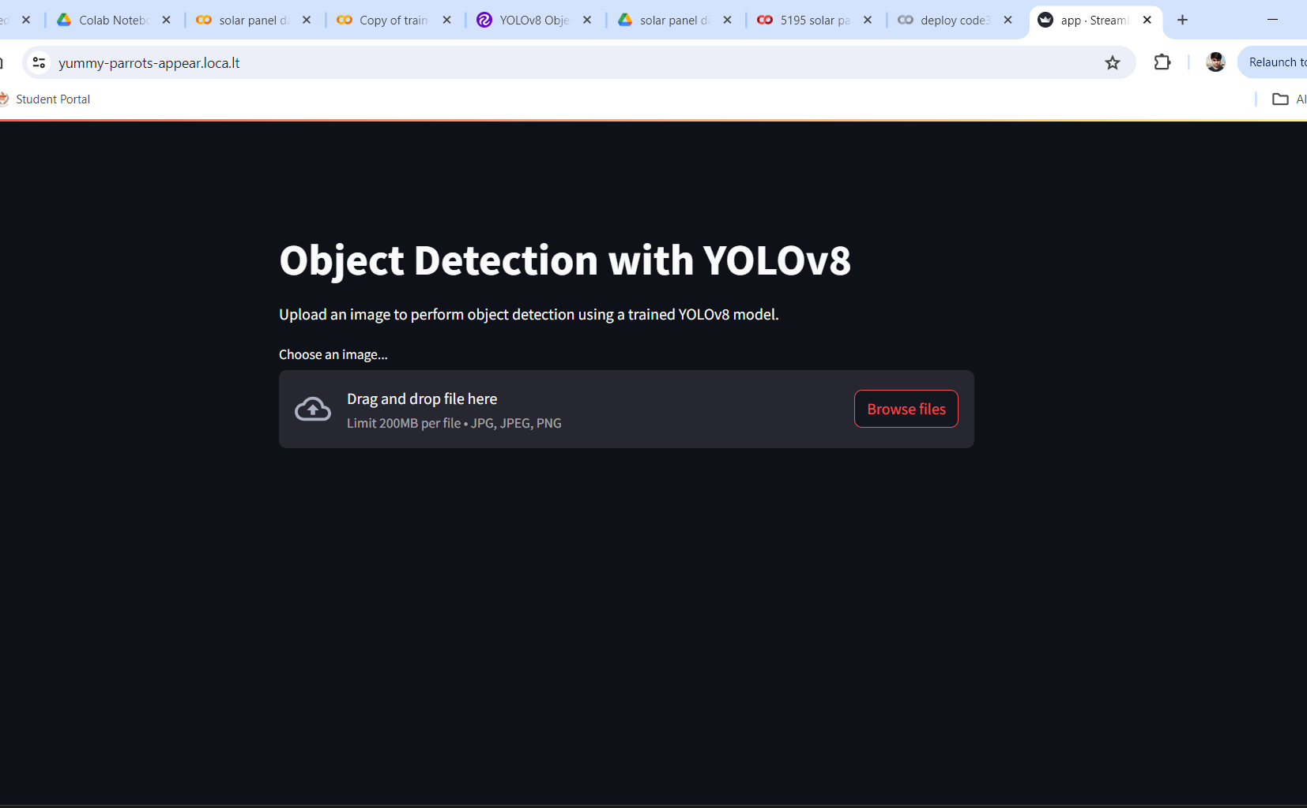
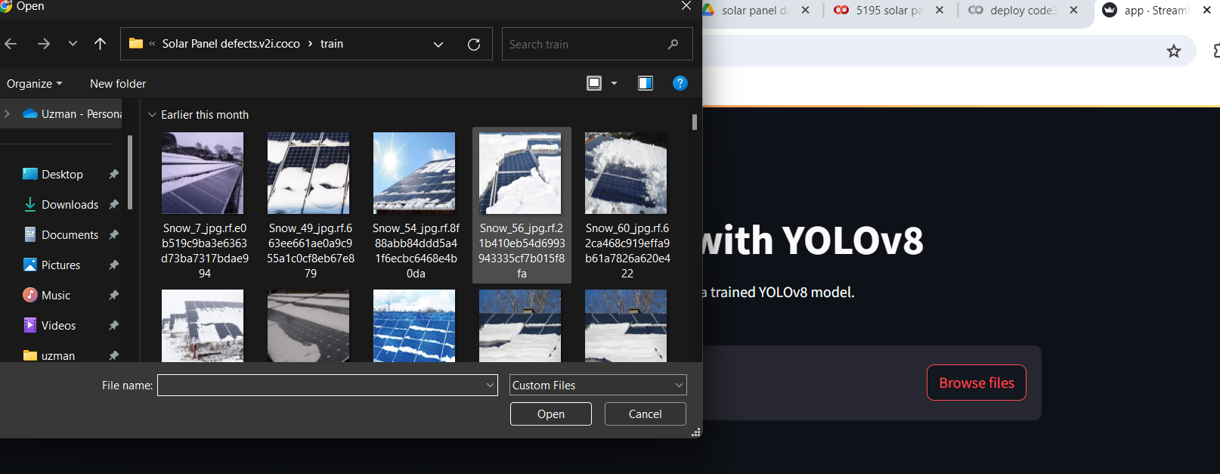
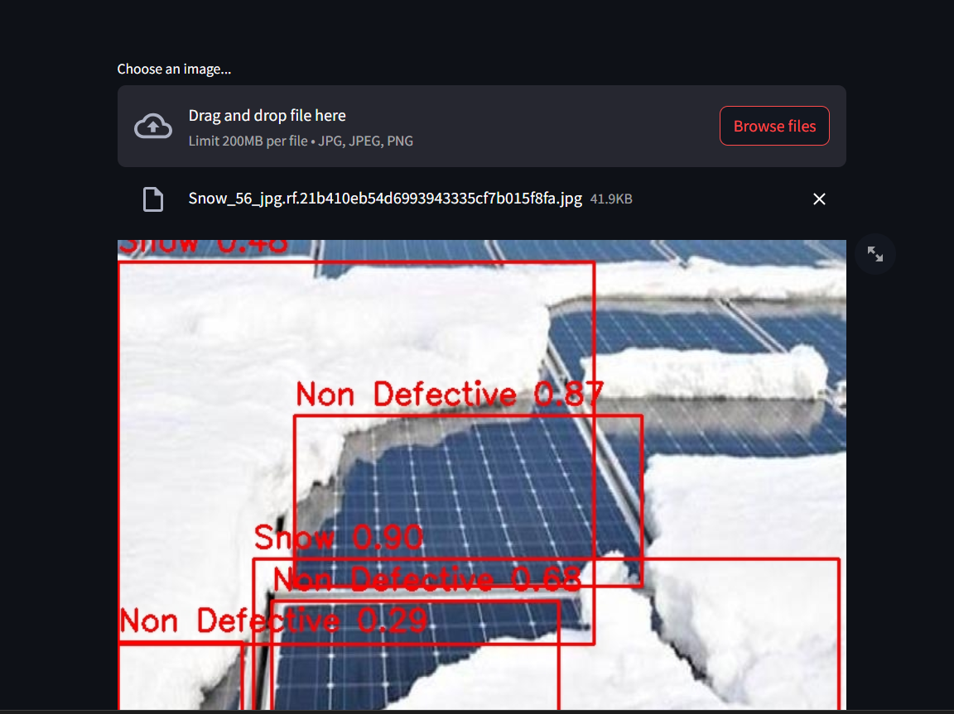
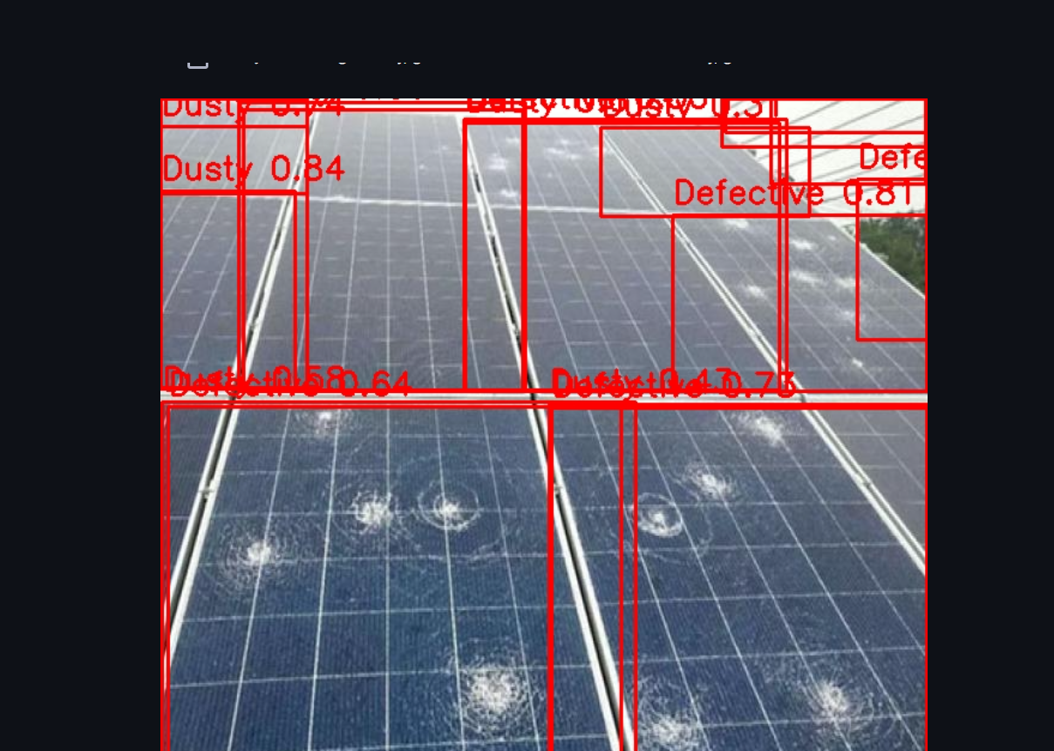
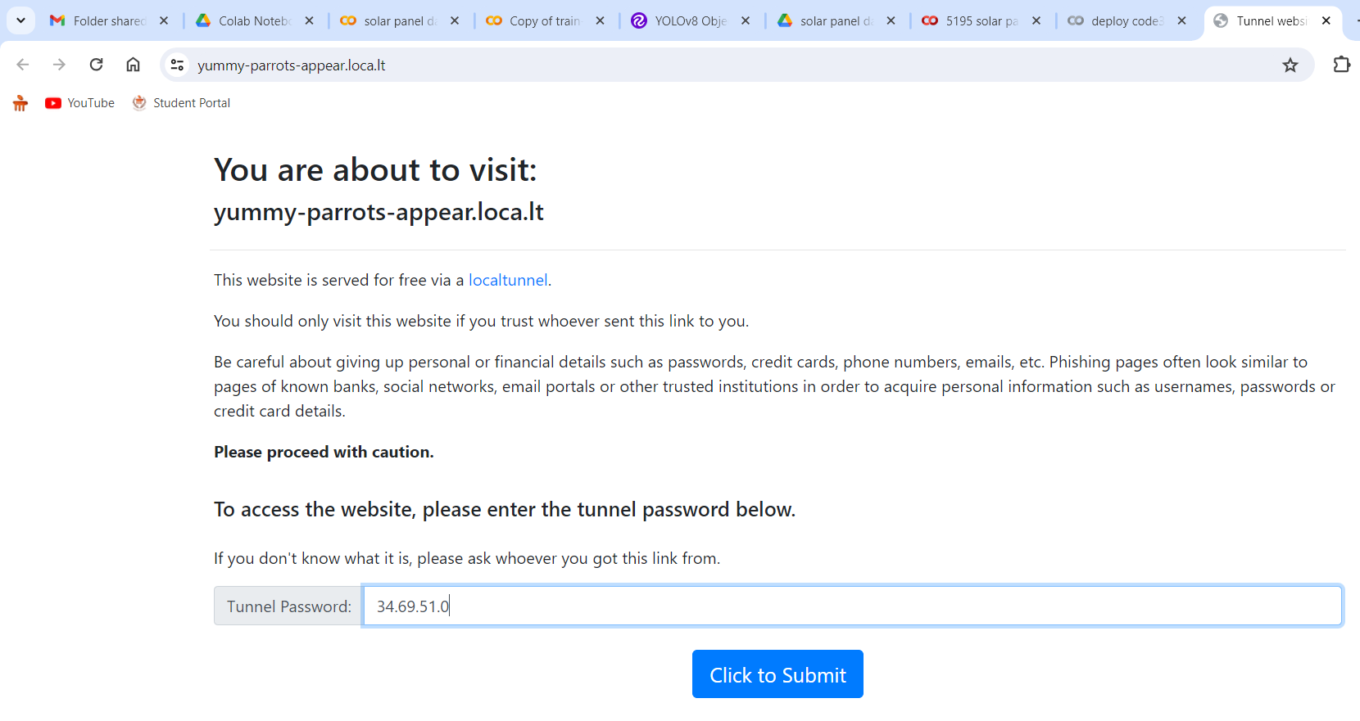
Screen shot of output

Slide 24

Video of output

Slide 25
Challenges
1. Limited Data for Minority Classes
Challenge: There might be very few samples available for some classes, making it difficult to apply data augmentation or resampling techniques effectively.
Solution: Focus on collecting more data for the minority classes or use advanced data augmentation techniques to generate synthetic samples.
4. Maintaining Data Quality
Challenge: Augmentation techniques can sometimes produce unrealistic samples, reducing the overall quality of the dataset.
Solution: Carefully select augmentation parameters and visually inspect a subset of augmented data to ensure it maintains the quality and diversity of the original dataset.
2. Overfitting to Augmented Data
Challenge: Models may overfit to the augmented data, especially if the augmentations are not diverse enough.
Solution: Apply a wide range of augmentation techniques and ensure that the augmented data closely resembles real-world variations.
3. Computational Resources
Challenge: Data augmentation and resampling techniques can be computationally expensive and time-consuming.
Solution: Utilize efficient algorithms and, if possible, leverage hardware accelerations like GPUs for faster processing.

Slide 26
Future Scopes
Enhanced Data Collection and Integration
Advanced AI and Machine Learning Models
Predictive Maintenance
Real-Time Monitoring Systems
Enhanced Data Augmentation and Synthesis
1. Enhanced Data Collection and Integration
Improved Sensors: Development of more advanced sensors and drones for higher resolution and more accurate data collection.
2. Advanced AI and Machine Learning Models
Self-Learning Algorithms: Developing self-learning models that can continuously improve from new data without human intervention.
Hybrid Models: Using a combination of traditional image processing techniques and deep learning models to enhance detection accuracy
3. Predictive Maintenance
Failure Prediction: Creating models that not only detect existing damage but also predict potential failures before they occur.
4. Real-Time Monitoring Systems
Scalable Solutions: Developing scalable solutions that can monitor large solar farms efficiently
5. Enhanced Data Augmentation and Synthesis
Augmented Reality: Employing augmented reality for better visualization and understanding of damage types during inspection

Slide 27

Queries ?

Slide 28


